Slide 1
Capstone data project: Battery Adverse Events Analysis
Iacovos (Jake) Kyprianou, Nathan Smith
US FDA
Center For Devices and Radiological Health

Slide 2
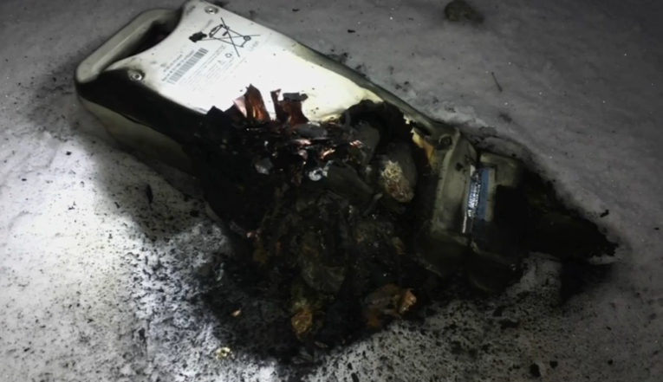
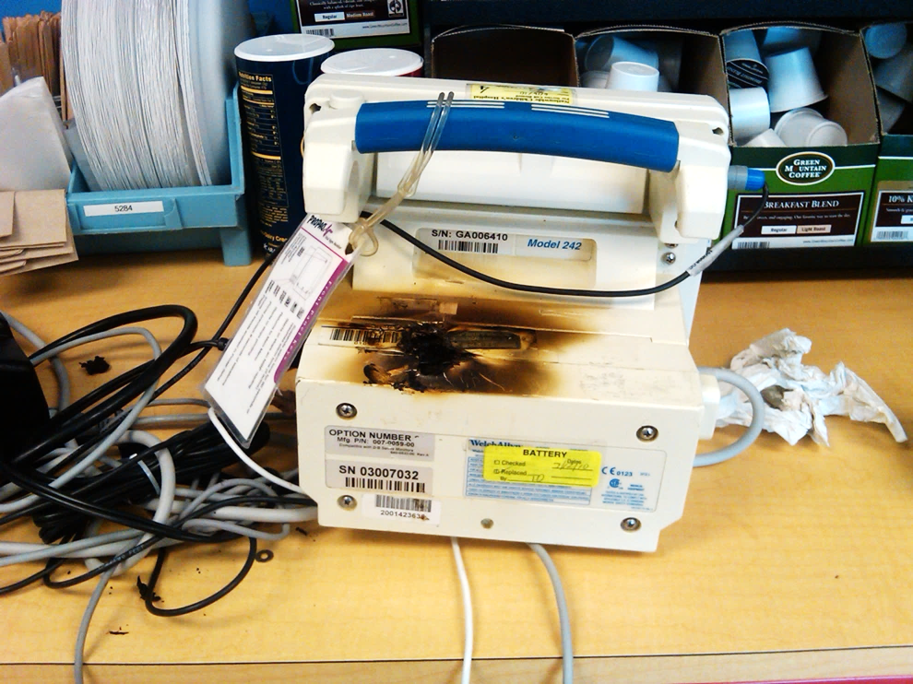

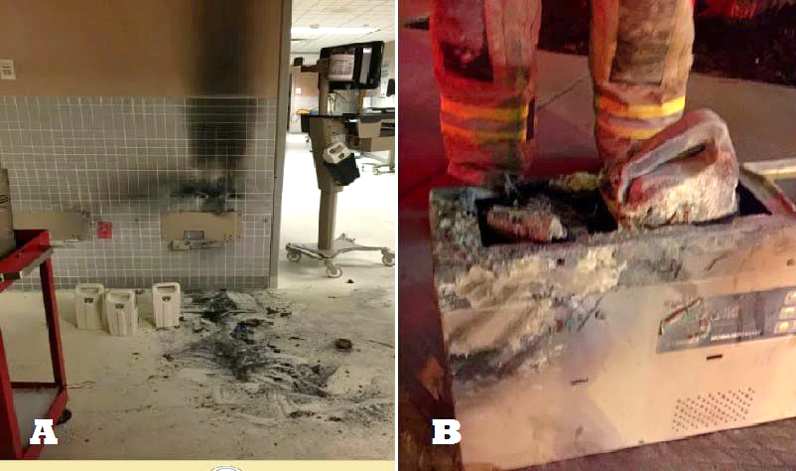
Notes:
Medical battery safety hazards can be divided into two main categories:
Functional hazards, such as premature or unexpected battery depletion which can result in failure to deliver needed and potentially life saving therapies.
Physical Hazards from catastrophic battery failures that can sometimes result in explosions and fires that can lead to hospital evacuations and adversely impact patient care.
Catastrophic battery failures can also, in rare occasions, injure the patient or user.
In today’s session we will primarily focus on the physical hazards of high capacity batteries as it is a low hanging fruit to address. We are hoping to tackle additional topics in future sessions.

Slide 3
Problem statement
Currently regulatory approach to reducing battery related adverse events is not data driven:
The battery related premarket safety questions and evidence the FDA asks for don’t consider real world failure modes
The postmarket surveillance and compliance strategy is largely reactive
End user:
Premarket submission review staff and consultants
Post market surveillance and compliance staff

Slide 4
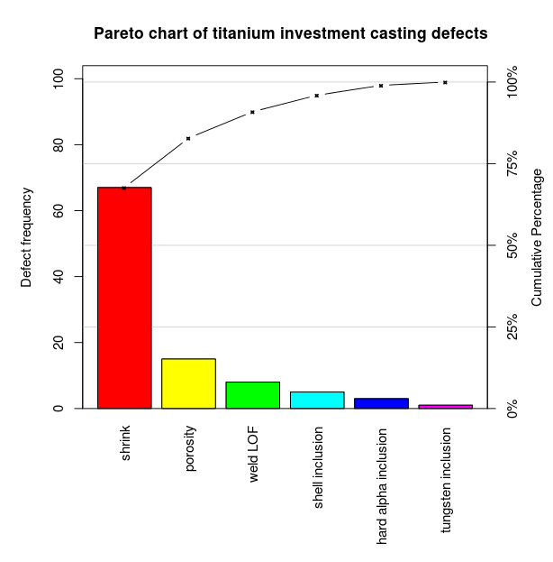
Our approach
Discriminate between battery and non battery related events
Develop Pareto Charts for battery adverse event types using text modeling techniques
Strategy:
Supervised: Discriminate between battery and non battery
Non-supervised: model topics using Latent Semantic Analysis and Latent Dirichlet Allocation
80% of the effects come from 20% of the causes.

Slide 5
openFDA API medical device adverse events
Text Processing
Tokenization
Remove numbers/punctuation/symbols/etc
Standardize letter cases (to lower)
Remove stop-words
Word base and word stems

Slide 6
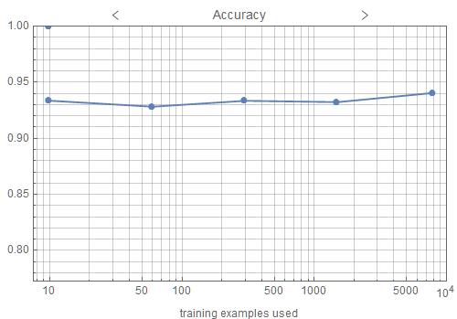
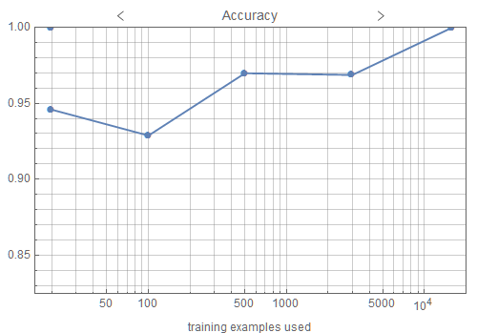
Classifier: Battery/Non-battery
Logistic regression
Markov Chain
Pacemaker Adverse events
Supervised/“Unsupervised” learning
Training set generated using simple term search for battery vs. non battery adverse events

Slide 7
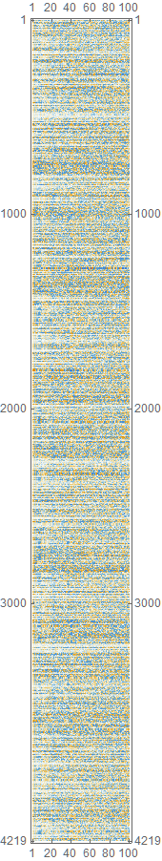
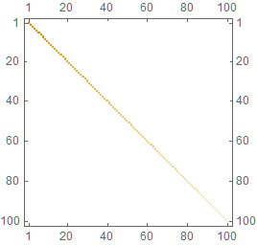
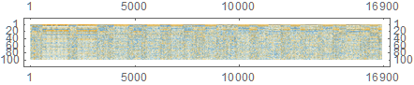
Latent Semantic Analysis (LSA)
Works similarly to the way the human brain works
Can be used for identifying synonyms
Document indexing
Topic modeling
Dimensionality reduction

Slide 8
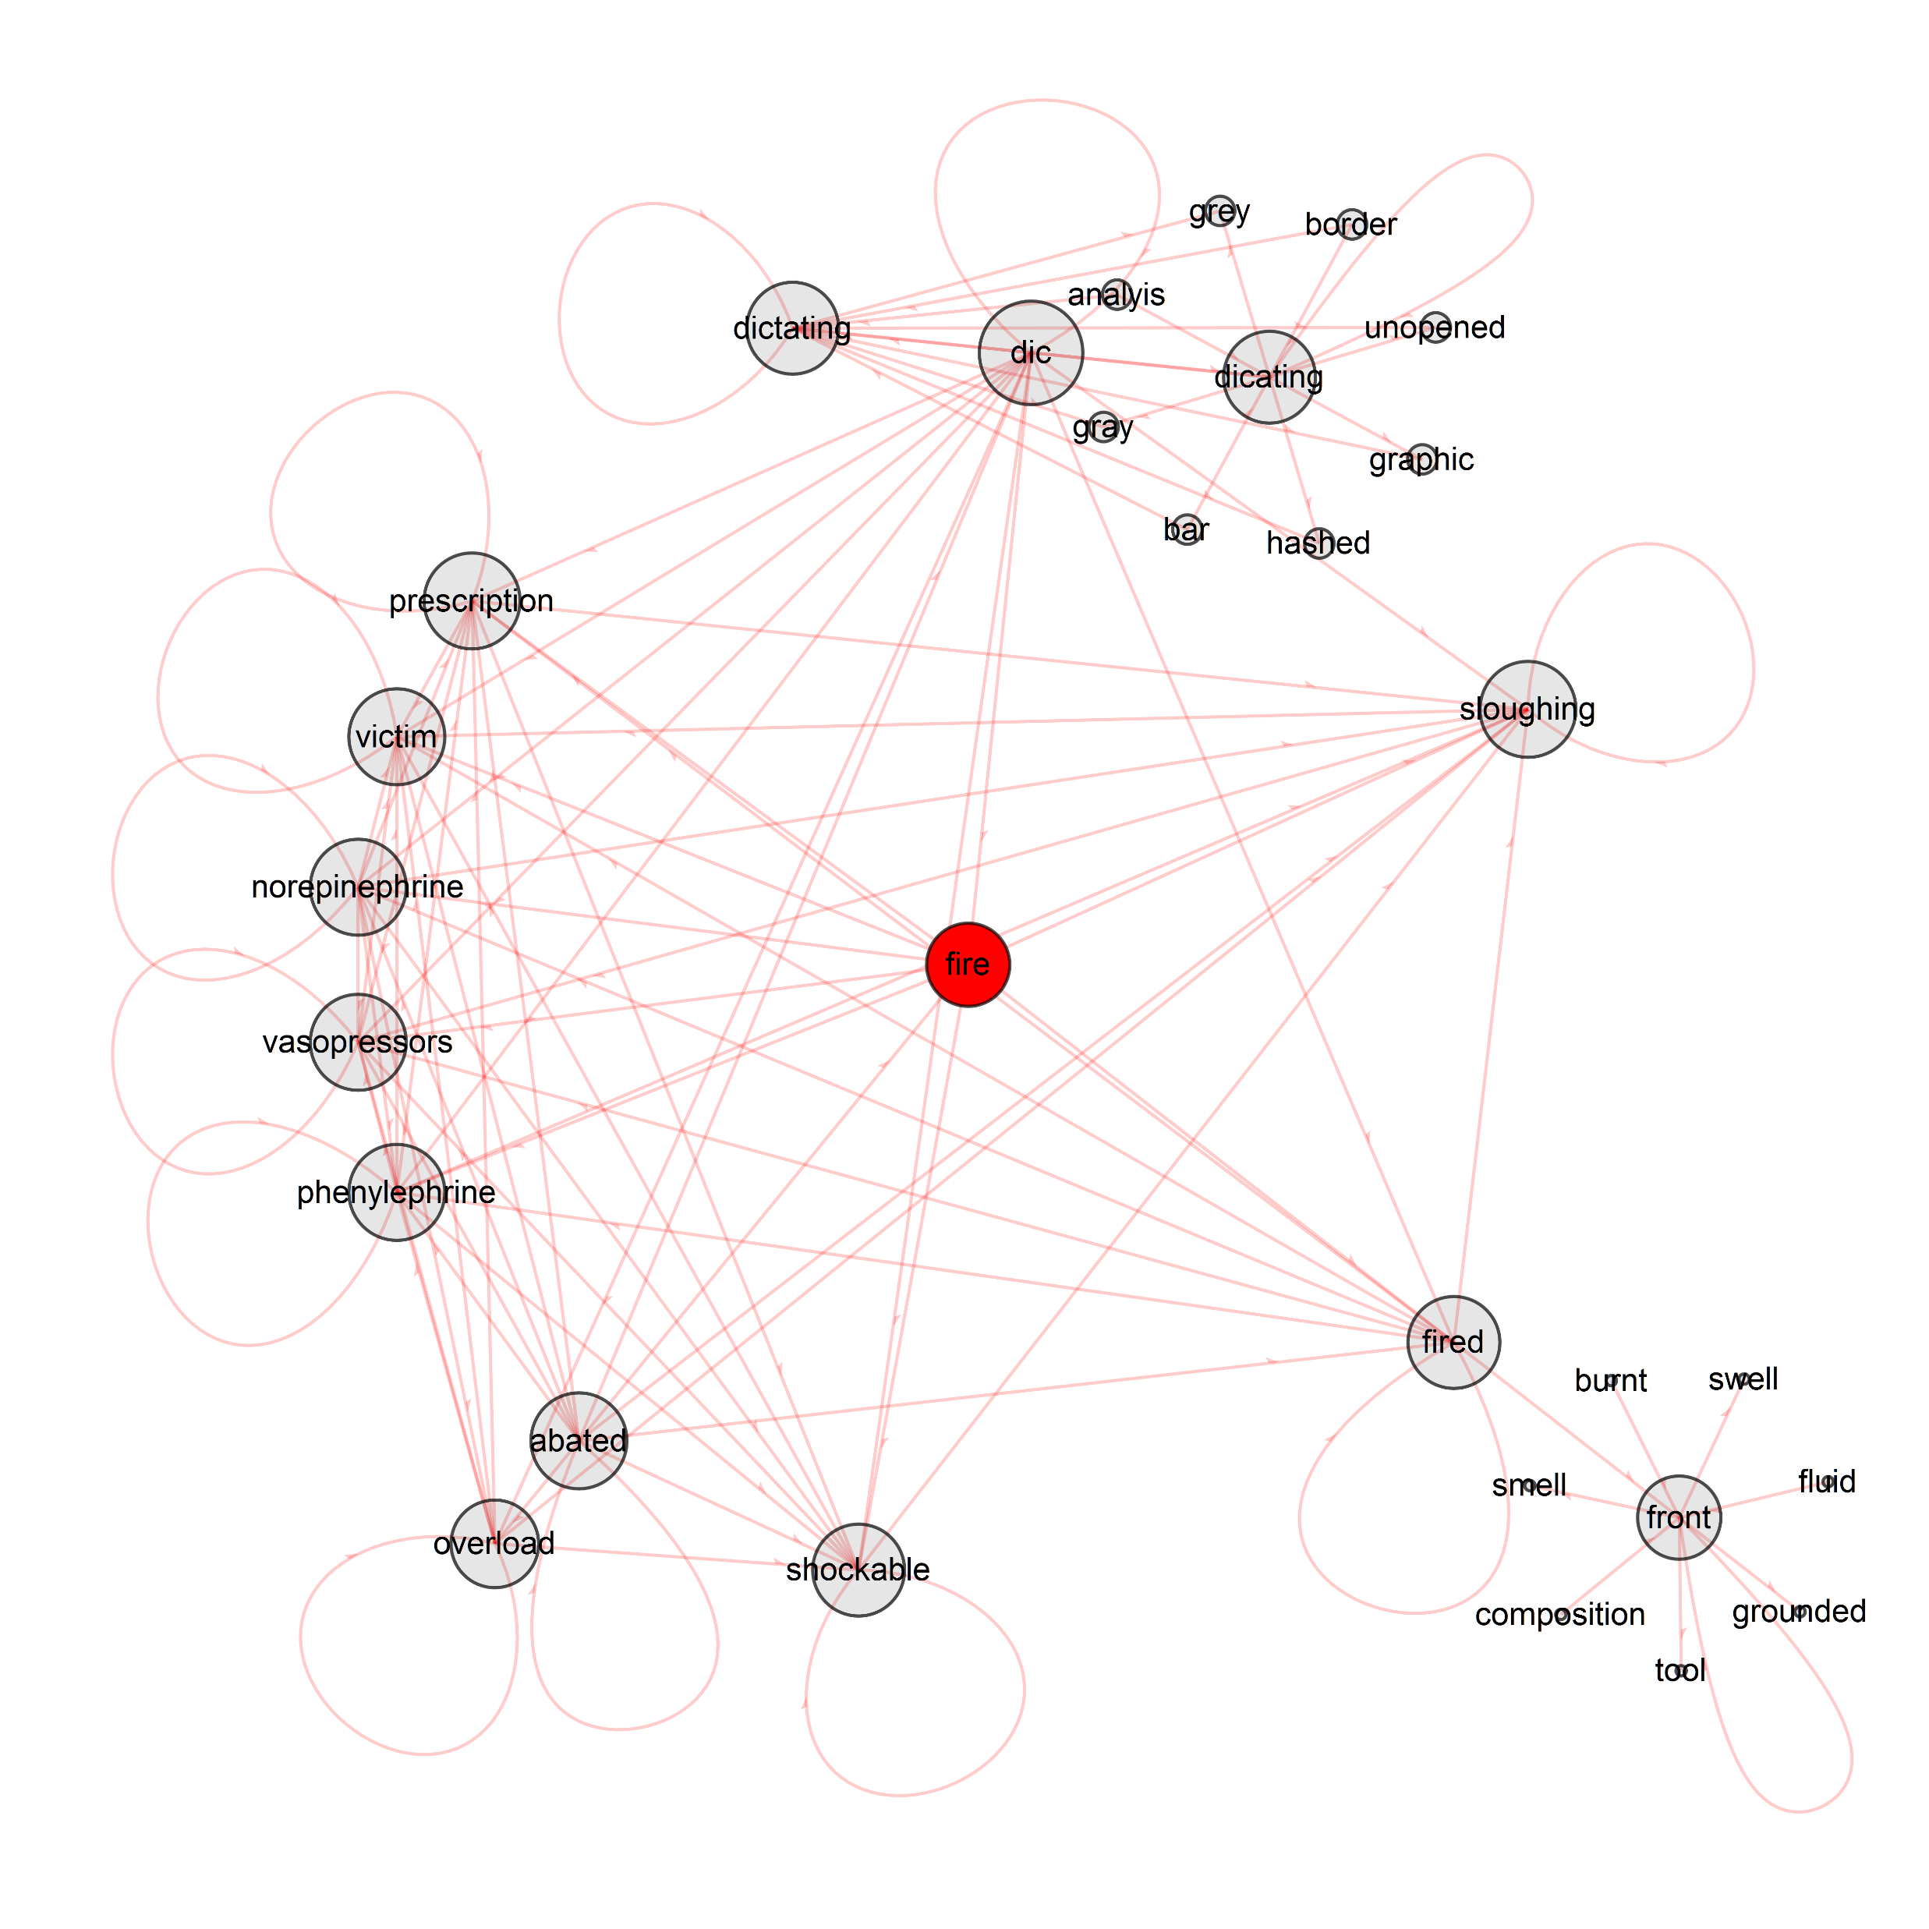
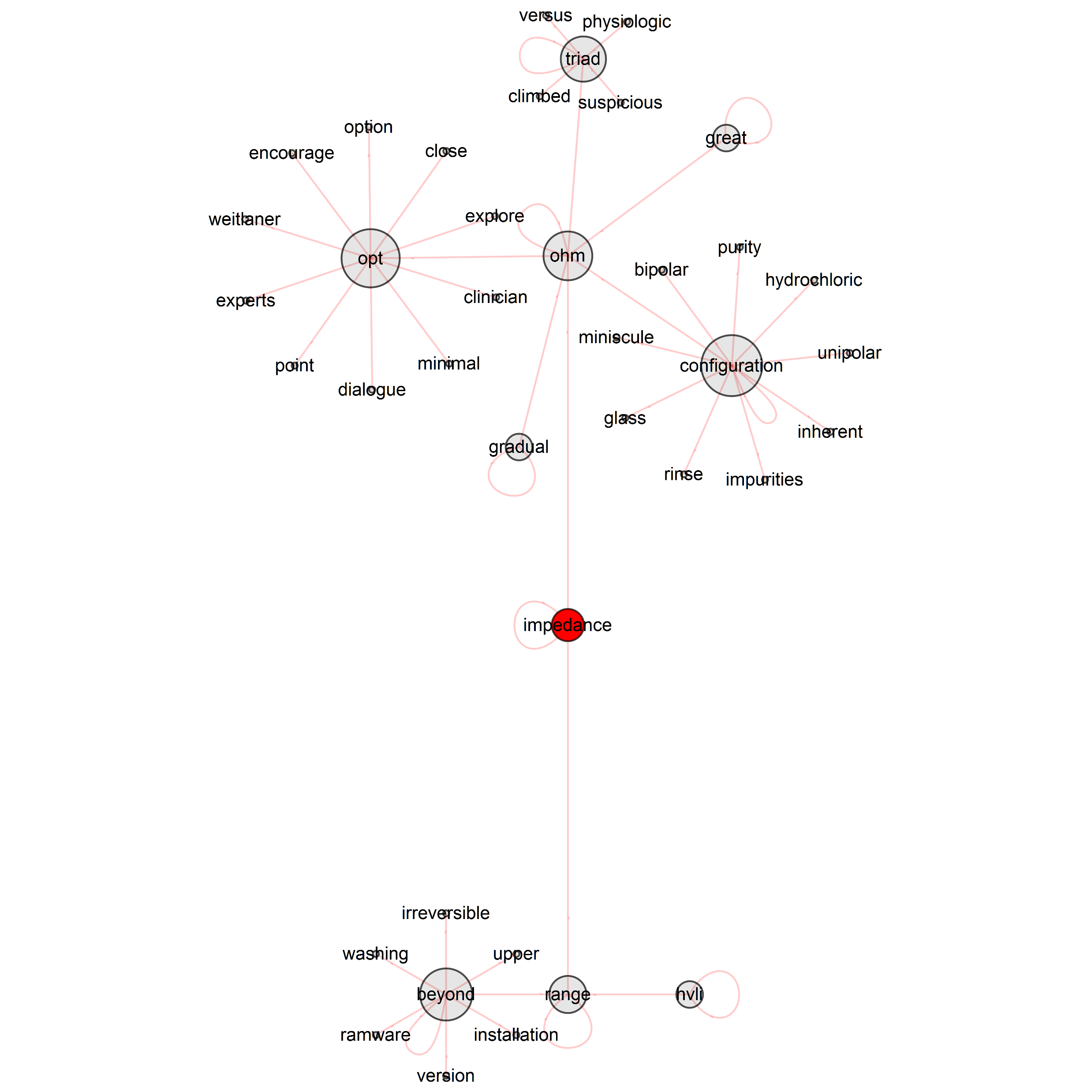

Slide 9
Latent Dirichlet Allocation (LDA)
Data
Document-Term Matrix
Specify K Topics
Feed into Algorithm
P(word/doc i ∈ Topic k)

Slide 10
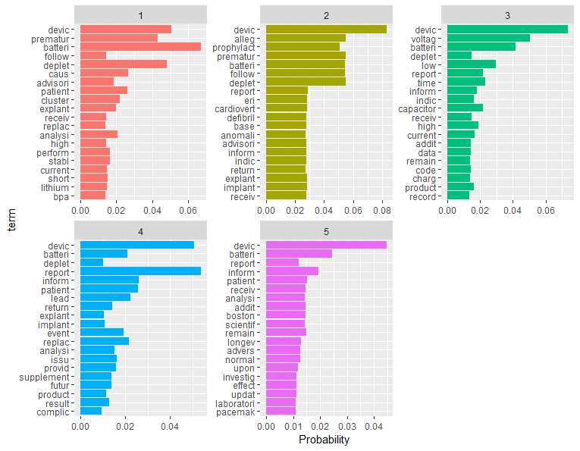

Slide 11
Experimenting with Word Correlation
Pairwise Correlation
Compares how likely it is that both word X and Y appear together relative to how often they appear separate
Word X | Word Y | Correlation
voltage | low | 0.9033551
battery | deplete | 0.5705818
lead | quickly | 0.0274501

Slide 12
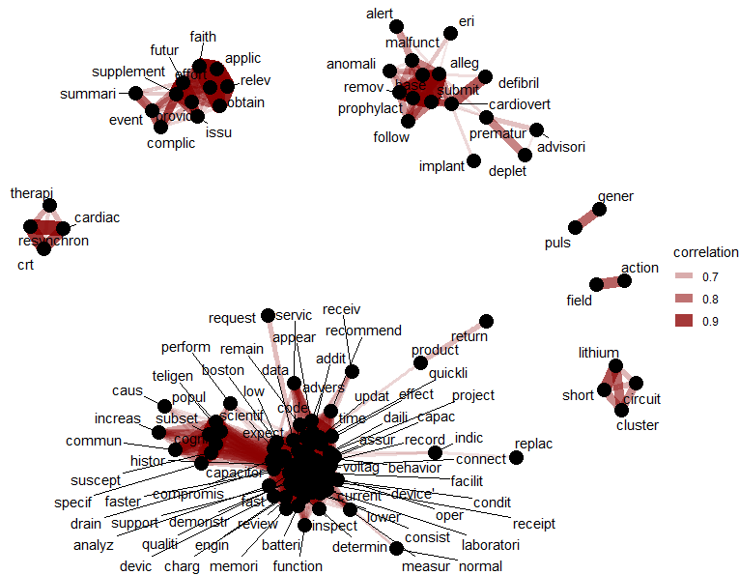
Cor >= .6

Slide 13
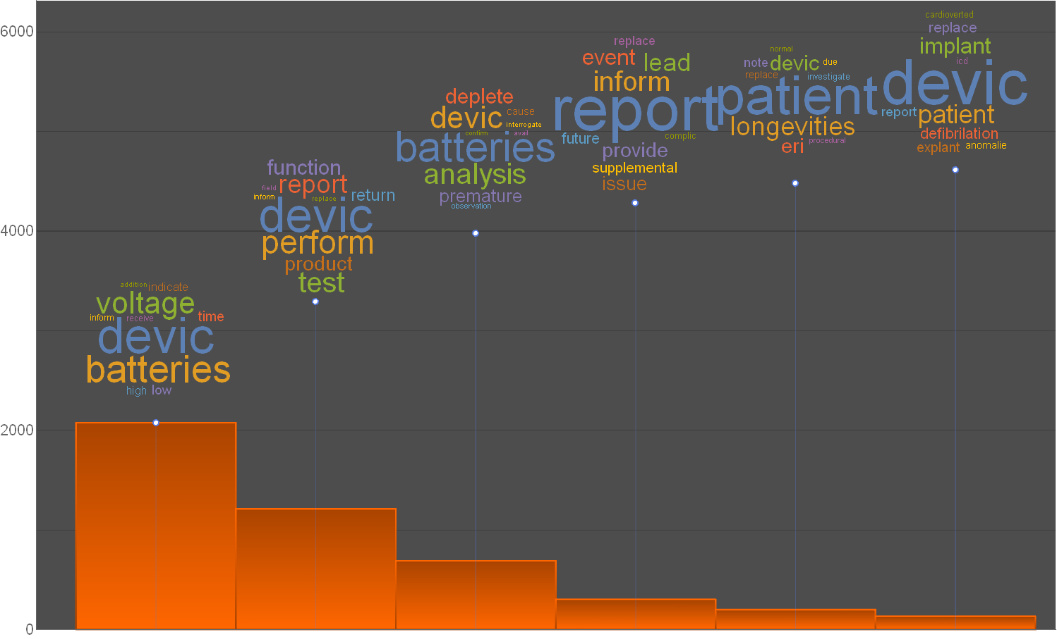

Slide 14
Conclusions
Classifier: Markov chains algorithm is slower and has lower accuracy
LSA: Allows for a multitude opportunities for automated learning
LDA: Grouping our bag of words into probabilistic topics has potential to help efficiently identify battery adverse event root causes
Still, some questions need answering (what is the optimum number k-topics?)
Other:
Correlation can help us identify which words are more likely to be associated with one another (synonyms)

